Slide 1



The mapml proposal - Part one
Peter Rushforth
September 23rd 2020
W3C/OGC Joint Workshop Series on Maps for the Web
w3.org/2020/maps/
Notes:
Good morning. In this presentation I’ll give an overview of the MapML proposal.

Slide 2

Preface
MapML is the MVP of markup to support maps, like <video> etc
Why <map>? Need a declarative, semantic entry point for maps in HTML for various reasons:
Ethical: learn maps & geography through standards, least common denominator: HTML
Performance: rendering spatial content is demanding. Script is killing the mobile web, and maps are especially timely for mobile users. So, build maps into the rendering engine of browsers.
Ethics: Need to define and standardize what “accessibility” means in real life for maps and map users. It’s clear that like the Web, maps are for everyone, so let’s make that experience better and standard.
Improve the ROI on spatial information: establish an organic non-metadata approach for spatially indexing the Web so that everyone can benefit via search engine implementation.
HTML Design Principles are a framework to guide discussion
Progressive enhancement, graceful degradation are key design values
Notes:
MapML is a proposal to extend HTML, in the HTML namespace, to include elements and attributes that implement maps and layers. The objective of our proposal is to introduce a small set of HTML elements that will directly support maps and mapping applications, with approximately the same authoring complexity as <video> or <audio>, or <img>. WHY
Why do we need a <map> element, exactly? We need a <map> element to provide a declarative, semantic entry point in Web standards for a few reasons.
Above all, we need to standardize Web map client technology because we should: it is the ethical thing to do. We need to make standard Web maps learnable by kids, by not binding such an important facet of human existence, not to mention survival, to proprietary frameworks. Having made that decision, we need a <map> element to obtain more efficient rendering of spatial content. Next, we need to define and standardize what “accessibility” means for Web maps and especially map content. Finally, we need to establish an organic, not-based-on-metadata basis for spatially indexing Web pages, so that search engines can return search results based, not only on ranking the text of documents against search terms, but also based on spatial indexing of <map> elements in the page. Like the Page Rank algorithm, but instead of or as well as back-links increasing a hit’s relevance, the pages literally nearer to the search term would raise the result rank.
We propose to extend the existing <map> element, by adding attributes and new child <layer> elements. The <map> element is a reasonable candidate for extension not only because of the element name, but mostly because the element’s processing model is already that of an interactive, albeit static map with layers (represented by the img and area elements) and the image map semantics potentially provides a path to scriptless, accessible graceful degradation. This is the basis upon which other proposals to modify HTML have been successfully made, for example the <img srcset> attribute, among others. This approach also seems to be encouraged by various HTML design principles.
The design principles aren’t a license to propose changes to HTML, but they are a framework to help guide design discussions. So if you have concerns about any of the design you hear about today, please consider joining the group and contributing those ideas. If we consider a diversity of viewpoints and experience, we will achieve a stronger proposal.
The result of the proposed extension, whether it is results in a “map” element or something else, should be a map “widget” or viewer that is designed for accessibility and is progressively enhanceable, in other words scriptable. It is not the intention of the proposal to accommodate, by means of native browser implementation, all use cases of Web maps today. It is a key objective of the proposal to expose DOM APIs, events and other facilities (such as styling) that relate to loading, rendering, using and creating map content.

Slide 3
Agenda
Part 1
The key elements: <map>,<layer> and <extent>
Tiled Coordinate Reference Systems and Zoom Levels
Notes:
I’ve got more to talk about today than I have time for, so I will cover some of the big ideas first.
To begin, I’ll talk about the key elements of the proposal, the <map>, <layer> and the <extent> element.
Then, I’ll spend time talking about Tiled Coordinate Reference Systems, or TCRS, because understanding those concepts is the key making sense of most of the proposal.
I’ll introduce the agenda for Part two of this presentation at the end.

Slide 4
The <map> element
<!DOCTYPE html>
<html lang=“en">
<head> <title>Canada Base Map</title> </head>
<body>
<map projection="OSMTILE" zoom="4" lat="53" lon="-91" controls controlslist=“nofullscreen”>
<layer label="Canada Base Map" checked src=“…”></layer>
<layer label="Canada Weather Map">…inline content…</layer>
</map>
</body>
</html>
A small set of ‘projection’ values is defined. The default, if unspecified, is ‘OSMTILE’, which corresponds with Web Mercator.
Required lat / lon numeric attributes designate the starting location
Boolean ‘controls’ attribute turns controls on / off. Controls are created by default in a closed shadow root, (like <video>)
The ‘controlslist’ attribute can prune the set of native controls provided
Required zoom integer-valued attribute defines the map scale
Notes:
Map projections define the coordinate system(s) in effect in the scope of the map so that coordinates of places on Earth, or potentially other planets too, may be drawn on a 2D plane; every map has a coordinate system that is shared by its layers. So, the proposed <map> element has a set of defined ‘projection’ values. The default value, if unspecified, is ‘OSMTILE’, which corresponds with Web Mercator. The set of projections is small, yet extensible, in the same way that, for example, HTML “rel” values are extensible, in other words: by agreement. I am using the attribute name “projection” here as a user-friendly term to describe the concept that I call “Tiled Coordinate Reference Systems”, or TCRS. The term TCRS is defined in this proposal and represents a framework for naming and discussing the integrated concepts of tile caches, geospatial coordinate reference systems, and Web map client concerns.
Web maps all define their starting conditions, typically via a lat/lon coordinate pair representing the centre of the map, so the <map> element has required lat/lon attributes describing its starting centre point. On the Web, as in real life, maps have scale, so the <map> element has a required zoom attributes which define the starting scale. This is actually a very important point, and one that can go unrecognized: Web maps are, in fact, “real life” maps, in which paper or mylar has been exchanged for pixels, *everything* that is represented must be represented according to an intended scale, including geographic features.
The boolean ‘controls’ attribute turns controls on / off. Controls are created by default in a closed shadow root, (like <video>). The ‘controlslist’ attribute can prune the set of native controls provided

Slide 5
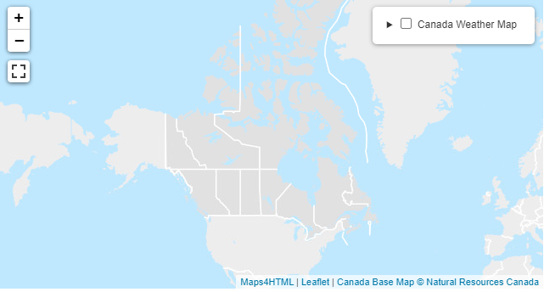
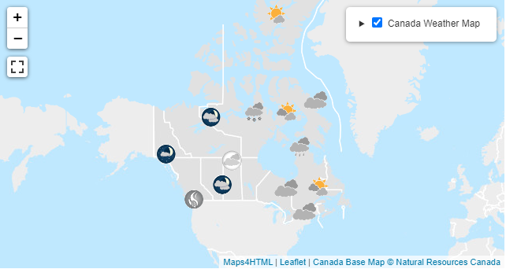
The <layer> element
<!DOCTYPE html>
<html lang=“en">
<head> <title>Canada Base Map</title> </head>
<body>
<map projection="OSMTILE" zoom="4" lat="53" lon="-91" controls>
<layer label="Canada Base Map" hidden checked src=“…”></layer>
<layer label="Canada Weather Map" hidden>…inline content…</layer>
</map>
</body>
</html>
A ‘hidden’ layer is not shown in the layer control, but is rendered on the map
Layers can have inline light DOM content OR a src attribute pointing to content (processing similar to <img src=“*an.svg”)
checked
Layers are children of the <map> element only, and do not nest.
A layer has a text label attribute
A ‘checked’ layer renders on the map.
Notes:
We need a <layer> element to be a child of the <map> element, because map layer is a primitive abstraction that is shared by many if not most maps, both on and off the Web.
<layer> elements represent map content, and each must share the coordinate systems defined by the parent <map> element’s projection attribute.
Map layers and their content are in light DOM, in the same way that SVG content is in the DOM. Layers are added according to the painter’s model, in document order. Their label attribute will appear in document order in the layer control.
Layers are children of the <map> element only, and do not nest.
Content can be inline or located in a document at the ‘src’ attribute URL (more on this later).
A layer has a text label attribute
A ‘checked’ layer renders on the map.
A ‘hidden’ layer is not shown in the layer control but is rendered on the map. This can be useful for preventing the user from turning off important content and becoming confused.

Slide 6
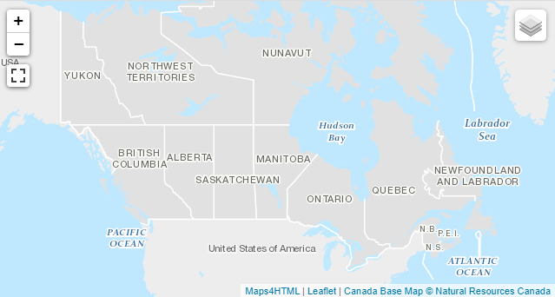
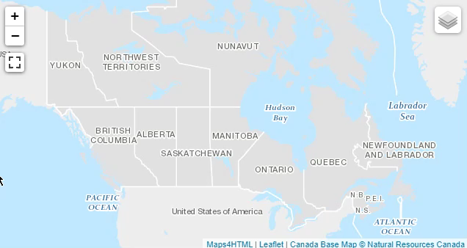
The <extent> element
<!DOCTYPE html>
<html lang=“en">
<head> <title>Canada Base Map</title> </head>
<body>
<map projection="OSMTILE" zoom="4" lat="53" lon="-91" controls>
<layer label="Canada Base Map" checked>
<extent units="OSMTILE">
<input name="z" type="zoom">
<input name="y" type="location" units="tilematrix" axis="row">
<input name="x" type="location" units="tilematrix" axis="column">
<link rel="tile" tref="https://.../GEOM_3857/{z}/{y}/{x}/">
<link rel="tile" tref="https://.../TXT_3857/{z}/{y}/{x}/">
</extent>
</layer>
</map>
</body>
</html>
Notes:
Layers have can have inline content (as shown here) that is loaded and rendered by the browser.
Web maps need a standard mechanism to load map data, that does not involve knowing how to access server APIs, beyond the strict uniform interface of HTTP. Browsers standardized HTML <form>s as a means to flexibly request and transmit data to and from any server, within the constraints of the HTTP uniform interface. Web map server data comes in a wide and growing variety of formats and interfaces. This poses severe challenges for interoperability. So, we designed a mechanism for loading and accessing server information based on established patterns (for example, URL Templates) and standards (like WMS, WMTS and OpenStreetMap slippy maps) and informed by the HTML <form> element.
The <extent> element represents the part of a layer’s content that binds to the viewport of the map. The <extent> element is somewhat analogous to the <form> element, being the parent of various inputs and links, the values of which are serialized during <extent> processing. <extent> processing differs from <form> processing, in that the user is not expected to fill in input values manually, because the extent, being bound to the map viewport, triggers content requests automatically as the map requires new content to paint. New content is typically required as the user either manipulates the map (by panning or zooming), or the device (by rotating, or moving it).
The rel=tile value, shown here associated to tile-based URL templates, reflects a core abstraction in modern Web maps, that of map tiles. The rel value tells the browser what the purpose is of the resource that it is loading. So, as the rendering engine iterates over the tiles that it needs, the browser fires events which are serialized to variables identified by name. Each input variable binds to one or more variable references in the URL template links within the <extent> element scope. Once all the variable references are resolved, the URL template becomes an actual resource URL that is fetched and rendered. An extent can contain as many such URL template link as it needs to compose the map layer. In the example shown above the geometry and labels of the layer are referenced by separate links.

Slide 7
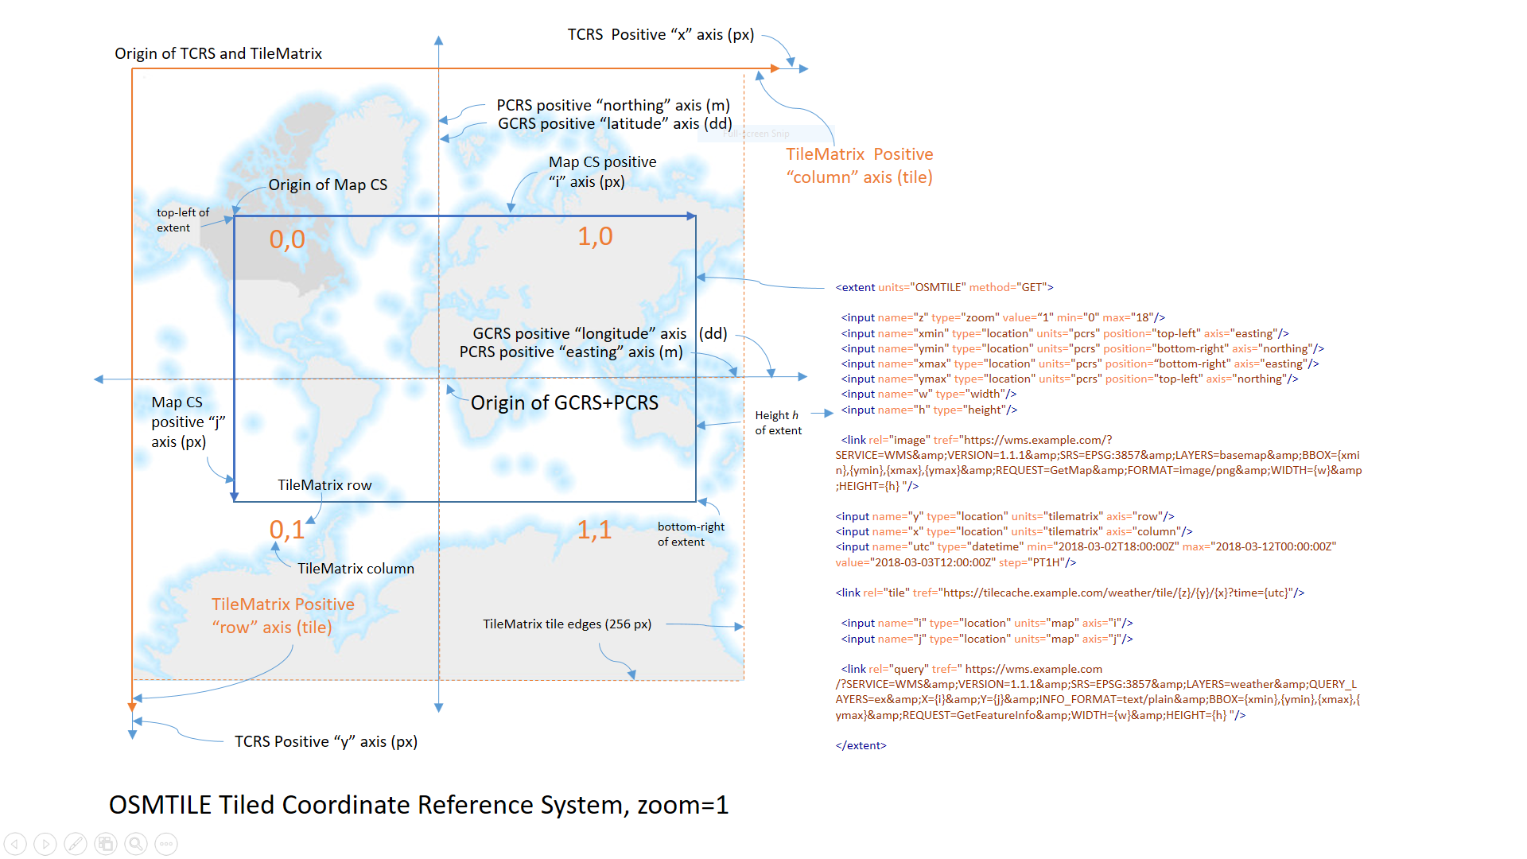
Tiled coordinate reference systems
Notes:
Tiled Coordinate Reference System, or TCRS, is a term coined by me to standardize and describe a system of talking about spatial coordinate reference systems from the Web client’s and users’ POV. When working with maps and spatial information, we inevitably need to talk about coordinate reference systems, and especially scale, and TCRS is my attempt to unify the vocabulary for CRS so that this core concept can be made interoperable and teachable.
tcrs cs - pixel – resolution – zoom – map cs – tile cs – gcrs cs – pcrs cs – tilematrix cs – extent – viewport - axis - position - location – units – projection – transformations – horizontal/vertical – width/height - rel

Slide 8
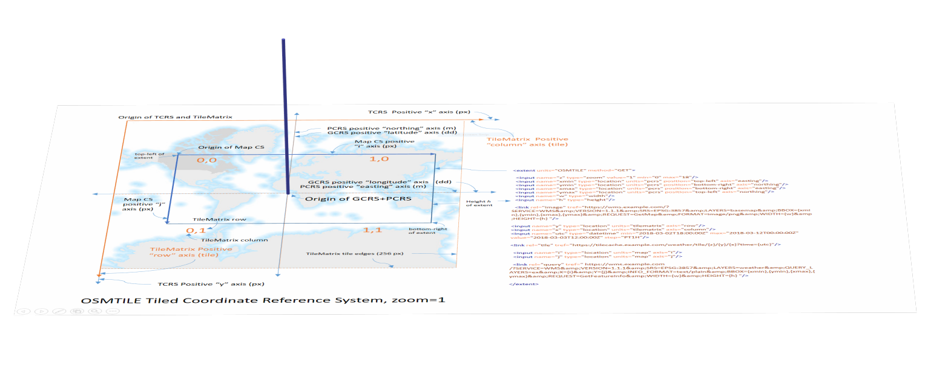
Zoom levels
156543.0339 m
A “pixel” at zoom = 0
0
0
25
17
Notes:
Historically, Geographic Information Systems have kept the concerns of map scale separate from those of the coordinate systems definition, by maintaining intimate and detailed metadata about the coordinate systems of the data they manage, so that data can be interoperably combined or overlayed at run-time. Web architecture requires that resource metadata be encoded into media type specifications, so that run-time exchanges are not necessary or desirable. So, we needed to develop the TCRS concept in order to encode it into the MapML or eventual HTML specification.
A TCRS has a defined number of integer zoom levels. A zoom level is an integer proxy for expressing a real-world distance units per pixel ratio, in other words pixel size, at a defined location, depending on the projection, typically the projection origin. The reason the set of zoom levels is defined, and not infinite is because in some cases there isn’t a mathematical relation between zoom levels, in other words they’re not necessarily evenly spaced as shown – they may have been chosen for reasons specific to the application and the fact that beyond a certain distance per pixel it doesn’t make real-world sense. By agreement and specification then, the zoom levels are defined and known.

Slide 9
Tiled coordinate reference systems
Notes:
For each zoom level in a TCRS, there exists a pair of 2D coordinate system in which the units are pixels, and tiles respectively. These coordinate systems follow the conventions of coordinate systems in computer graphics, having their origin at the top left of the screen and with the vertical axis being positive down and the horizontal axis positive to the right of the screen. The pixel-based coordinate system is called a tcrs with axes named x and y. The tile-based coordinate system is called a tilematrix, after the OGC concept of that name, and its axes are named column and row.
Tiles are defined in 256-square aggregations of pixels, and the pixels and tiles are georeferenced by a defined planar transformation to the coordinate space defined by the projected coordinate reference system, or pcrs. The coordinates and units of the pcrs are defined by a mathematical transfer of coordinates to and from a defined geographic coordinate reference system, or gcrs, according to defined parameters of the projection method.
Two additional coordinate reference systems are defined, to correspond with the same concepts from the WMS and WMTS standards. The map coordinate system is defined by the map’s dynamic viewport and has its origin in the upper left corner of the map. The horizontal axis is named “i”, while the vertical axis is named “j”. This coordinate system corresponds to the img coordinate system in HTML’s client-side image maps. It is also used by WMS GetFeatureInfo requests to query server databases for features at a given pixel within a defined request. The tile coordinate system is created relative to each tile, and also has i and j axes. It is created in MapML in order to support WMTS GetFeatureInfo requests.

Slide 10
THANK YOU! Merci!
Peter.Rushforth@canada.ca
September 23rd 2020
W3C/OGC Joint Workshop Series on Maps for the Web
w3.org/2020/maps/
Notes:
Thank you

